Slide 1


Comprehensive Sales as per Retails
LOKESH​

Slide 2

Introduction
In retail, comprehensive sales refers to a strategic approach aimed at maximizing revenue by addressing all aspects of the sales process, from product offerings to customer interactions. It encompasses a wide range of activities and principles designed to create a seamless shopping experience, boost customer satisfaction, and drive consistent sales growth.

Slide 3
What is data ?
Data is a piece of information .
or
Data is a collection of facts, numbers, words, or observations that represent a concept or idea
What is SQL ?
SQL stands for Structured Query Language. It is a standardized programming language used to manage and manipulate relational databases. SQL allows you to perform tasks like querying data, updating records, inserting new data, and deleting records in a database.

Slide 4
What is MySQL ?
MySQL is an open-source relational database management system (RDBMS) that uses SQL (Structured Query Language).
It is widely used for managing databases and is known for its speed, reliability, and ease of use.
What is Group By Clause ?
The GROUP BY CLAUSE in SQL is used to group rows have the same values in specified columns into summary rows, like finding the total count or sum of data. It’s typically used with aggregate function such as
COUNT(), SUM(), AVG(), MIN(), and MAX() to perform calculation on each group of rows.

Slide 5

Understanding Customer Needs
To achieve retail success, it's crucial to understand your customer's needs and preferences. Conducting thorough market research and gathering customer feedback can help tailor your offerings and improve customer experience, leading to increased loyalty and sales.

Slide 6
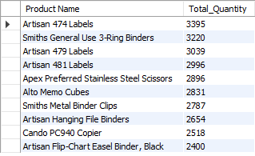
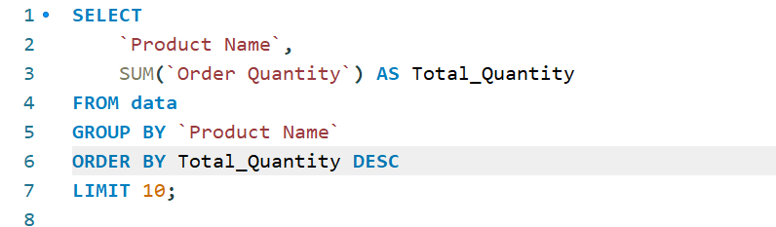
Top Performing Products

Slide 7
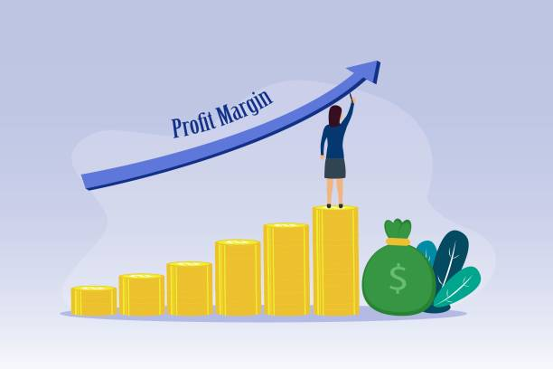
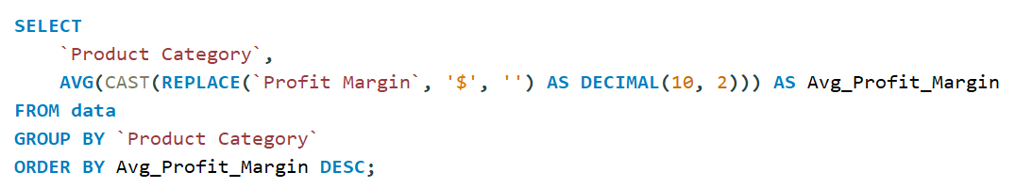
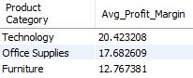
Profit Margin by Category

Slide 8
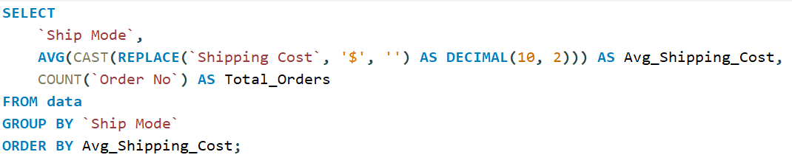
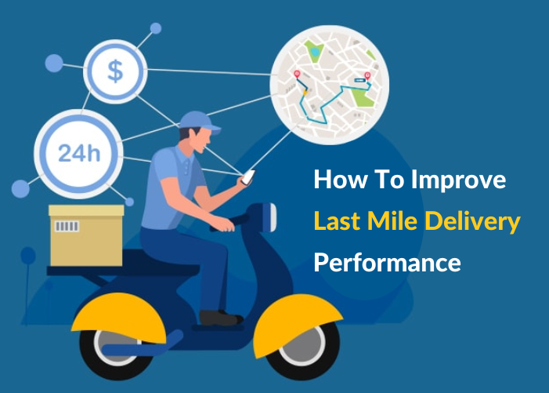
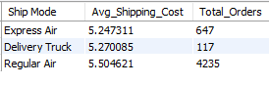
Shipping Performance

Slide 9
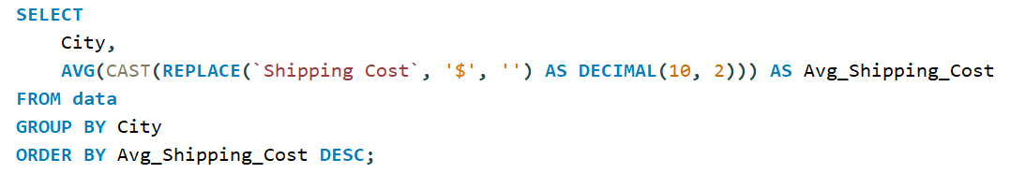
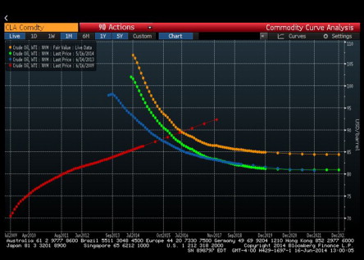
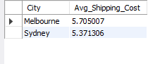
City Wise Shipping Cost Analysis

Slide 10
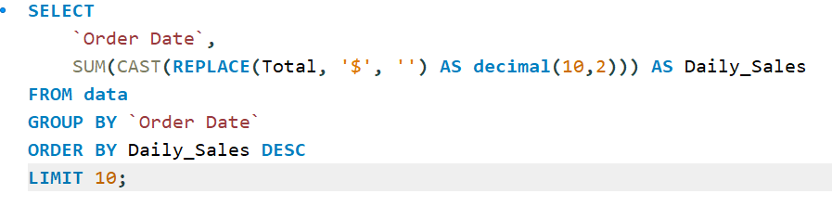
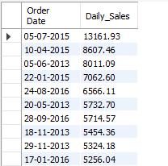
Peak Sales Days

Slide 11

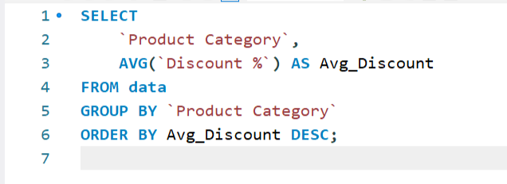
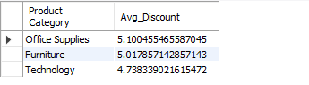
Discount Utilization by Product Category

Slide 12
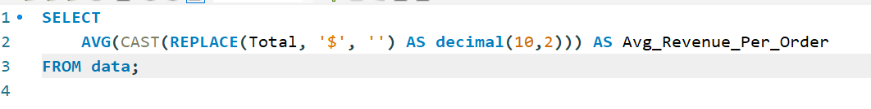
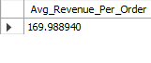
Average Revenue Per Order
What Average is Revenue Per Order
Average Revenue Per Order (ARPO) is a metric that tells you the average revenue generated by each order across the entire dataset. It's a great way to gauge how much customers typically spend per order and helps track business performance.

Slide 13
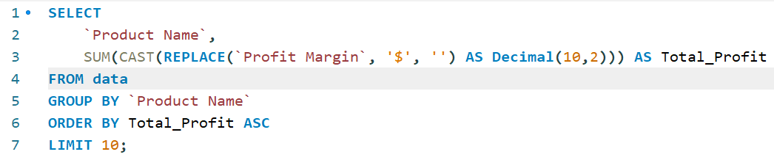
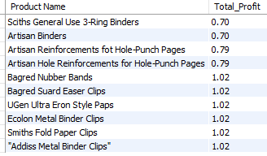
Low Profit Products
Low-profit products are items or goods that generate a relatively small profit margin compared to their cost or selling price. These products are typically sold at a price point that doesn't provide significant financial return for the business.

Slide 14
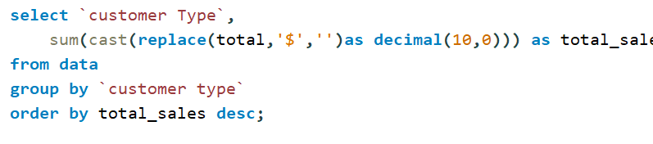
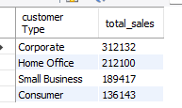
Sales Contribution by Customer Type

Slide 15
Summary
Understanding Customer Needs: Emphasizes the importance of knowing customer preferences to enhance sales strategies.
Top Performing Products: Identifies products that generate the highest sales.
Profit Margin by Category: Analyzes profit margins across different product categories.
Shipping Performance: Evaluates the efficiency and costs associated with shipping.
City Wise Shipping Cost Analysis: Breaks down shipping costs by city.
Peak Sales Days: Identifies days with the highest sales volume.
Discount Utilization by Product Category: Examines how discounts are used across different product categories.
Average Revenue Per Order (ARPO): Measures the average revenue generated per order, indicating customer spending behavior.

Slide 16

Thank you
LOKESH​
LOKESSHHH01@gmail.com

